Slide 1
Task 4 :
Weather API
Alexandria, Egypt
NASA POWER
2021–2025

Slide 2
01
The data
API, region and data quality

Slide 3
Region, range and API
Region & range
NASA POWER
Alexandria, Egypt. 1,826 daily records from Jan 2021 to Dec 2025
Free with no API key, queried by coordinates, so anyone can reproduce the call

Slide 4
Data preparation
1,826
0
0
Daily rows
Gaps
Missing
Datetime set; 7 variables: temperature (mean/min/max), rain, humidity, wind, cloud
No gaps or duplicates: every date appears exactly once, daily frequency
NASA's −999 flag turned into NaN, then handled (next slide)

Slide 5
Data quality checks
Check | Days flagged
Duplicate timestamps | 0
Missing dates in the index | 0
Missing values after cleaning | 0
Min ≤ mean ≤ max temperature violated | 0
Negative precipitation | 0
Humidity or cloud outside 0–100 % | 0
Day-to-day temperature jump > 10 °C | 0
Temperature flat-lined for 5+ days | 0
Missing-value strategy
Temperature, humidity, wind, cloud: interpolate gaps of up to 3 days.
Precipitation: never interpolated, as it is intermittent and interpolation would invent drizzle.
Units: °C, mm/day, %, m/s, consistent across the series.

Slide 6
02
Time series
Patterns, structure and anomalies

Slide 7
Descriptive overview
22.0°
0.47
79%
Mean temp (°C)
Mean rain
Dry days
Daily range 9.7 to 33.8 °C, std 5.5 °C
mm per day. Median is 0 mm; maximum 111.6 mm on 19 Mar 2021
Days under 0.1 mm. Rain is extremely skewed

Slide 8
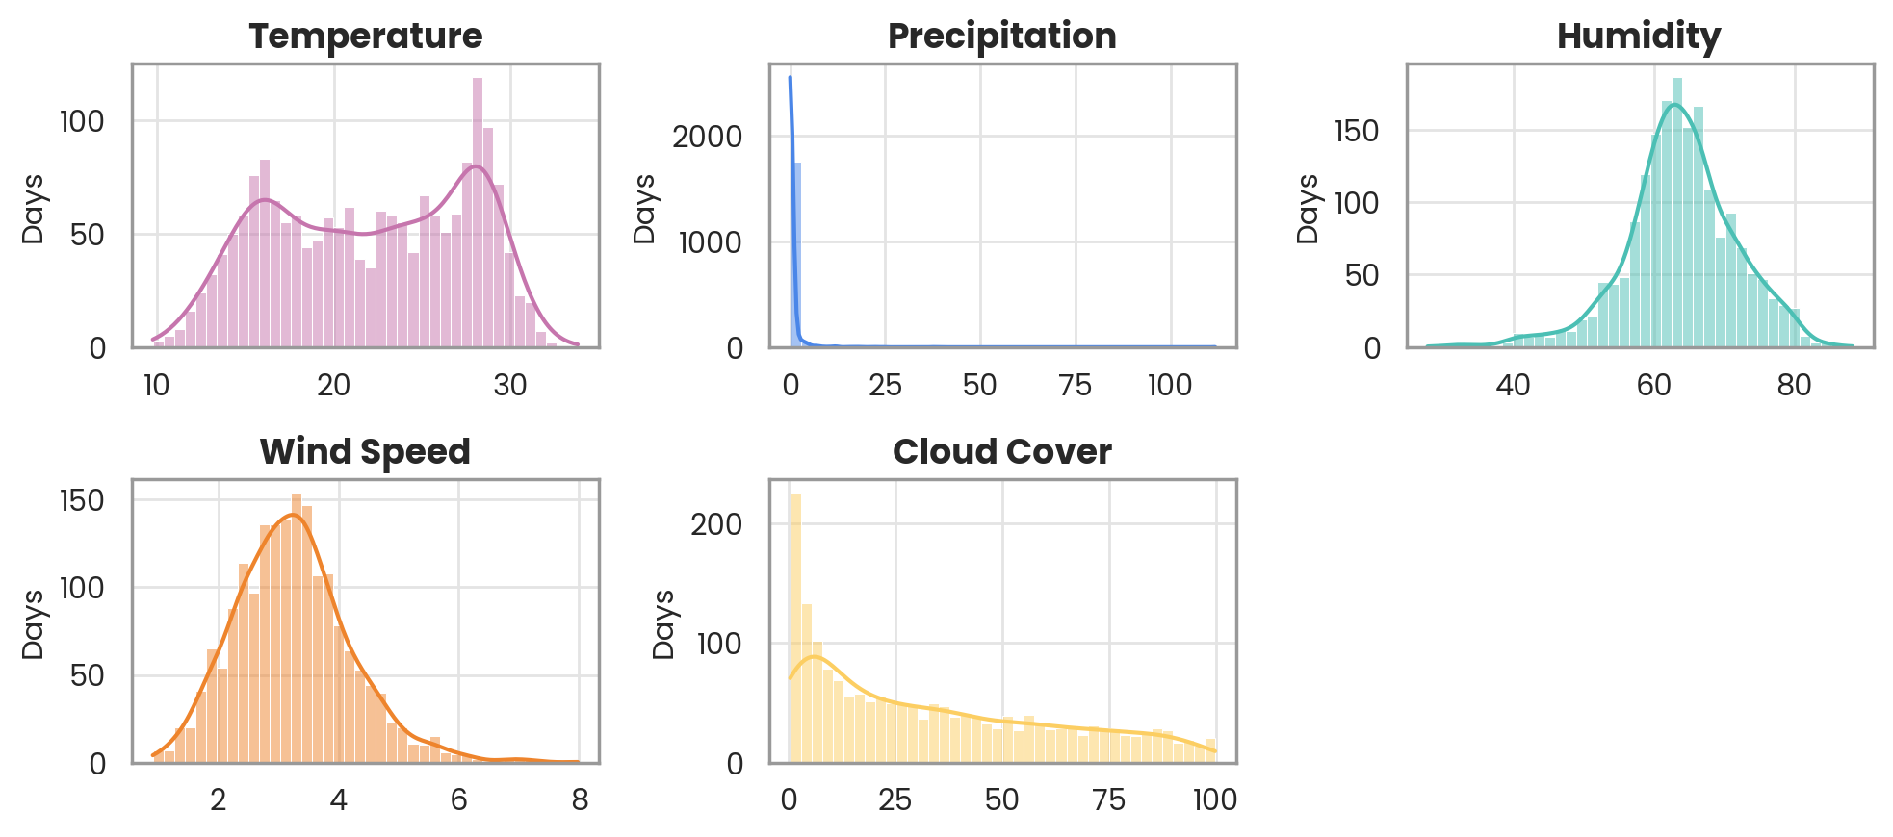
Distributions
Temperature is bimodal (cool and warm seasons); rain is zero-inflated and heavily right-skewed.

Slide 9
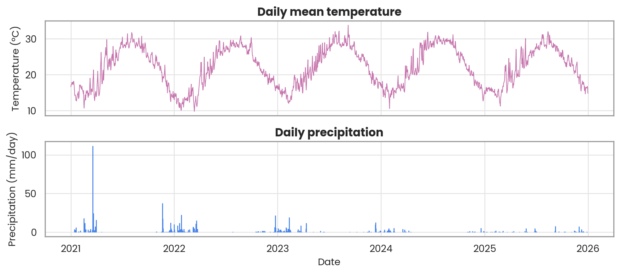
Temperature and rain over time
Clear yearly temperature cycle; rain only in winter, plus one extreme spike on 19 Mar 2021 (111.6 mm).

Slide 10
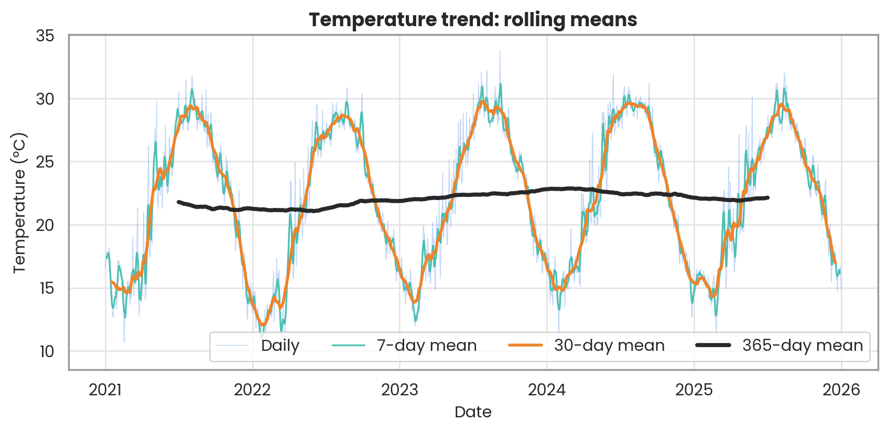
Trend: rolling means
The 365-day mean stays within about 1 °C: the seasonal cycle dominates and any trend is small.

Slide 11
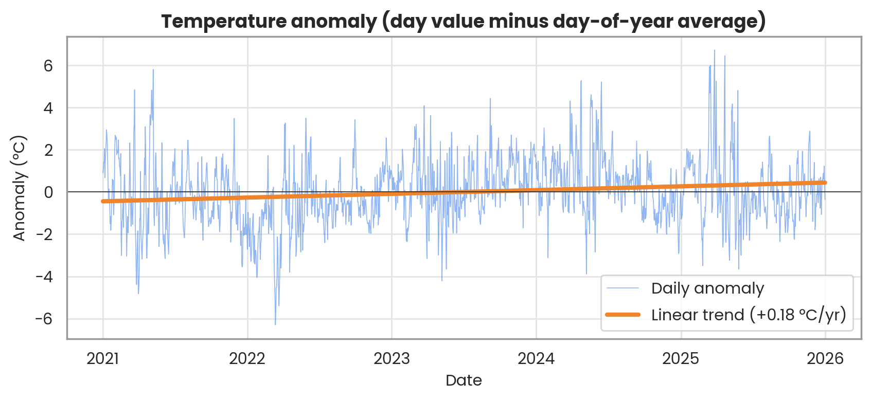
Trend: temperature anomaly
+0.18 °C/yr (daily p < 0.001, R² = 0.03), but yearly means give p = 0.28: not reliable.

Slide 12
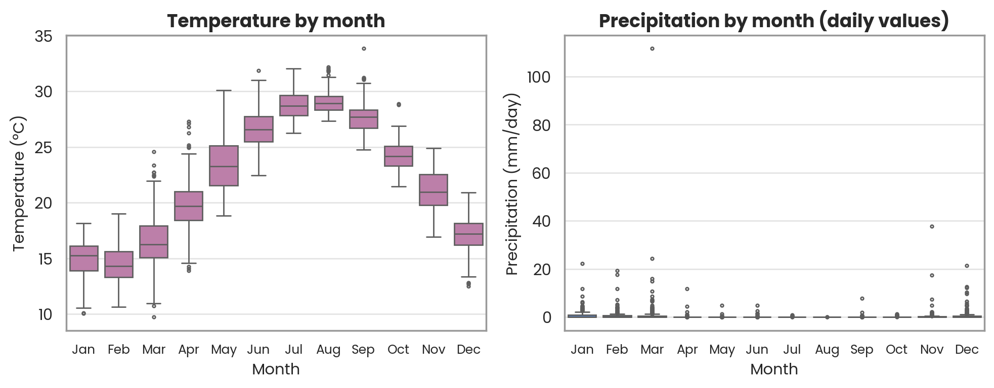
Seasonality by month
Warmest in Aug (29.1 °C), coolest in Feb (14.4 °C); 92% of rain falls Nov–Mar.

Slide 13
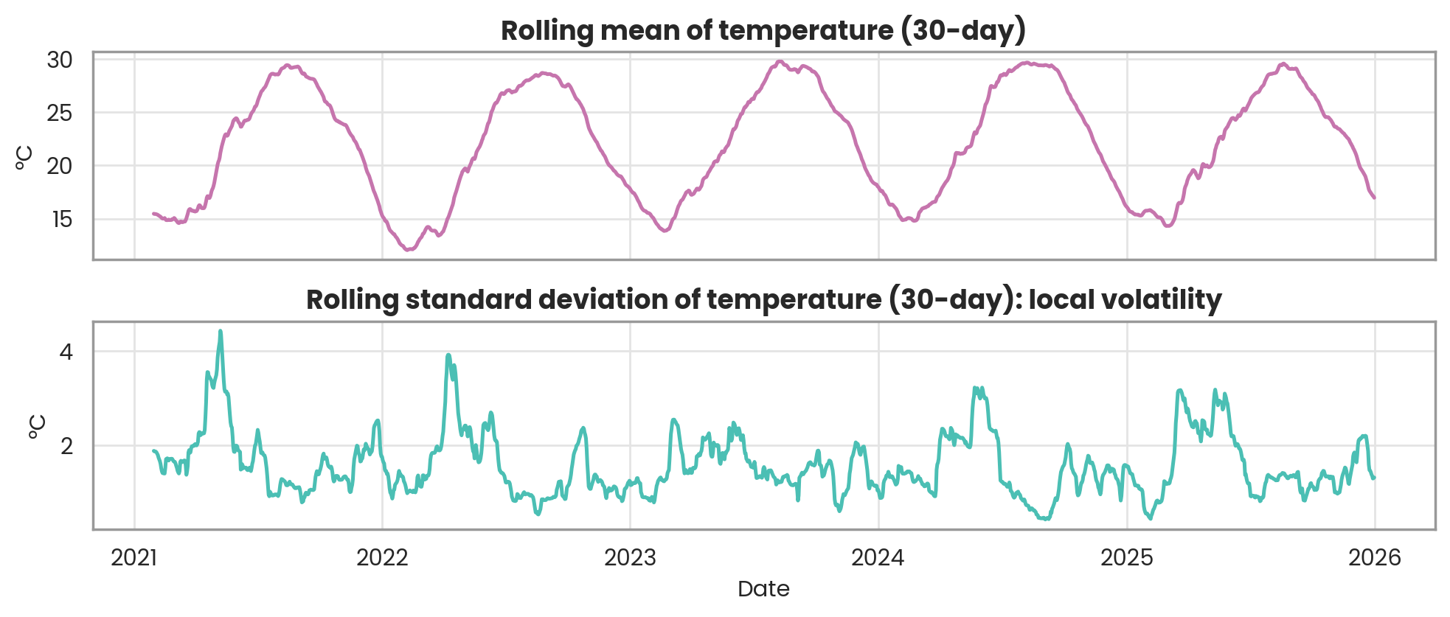
Rolling mean and volatility
Volatility peaks in spring (Apr–May, std ≈ 2.5 °C) and is lowest in late summer (≈ 1.0 °C).

Slide 14
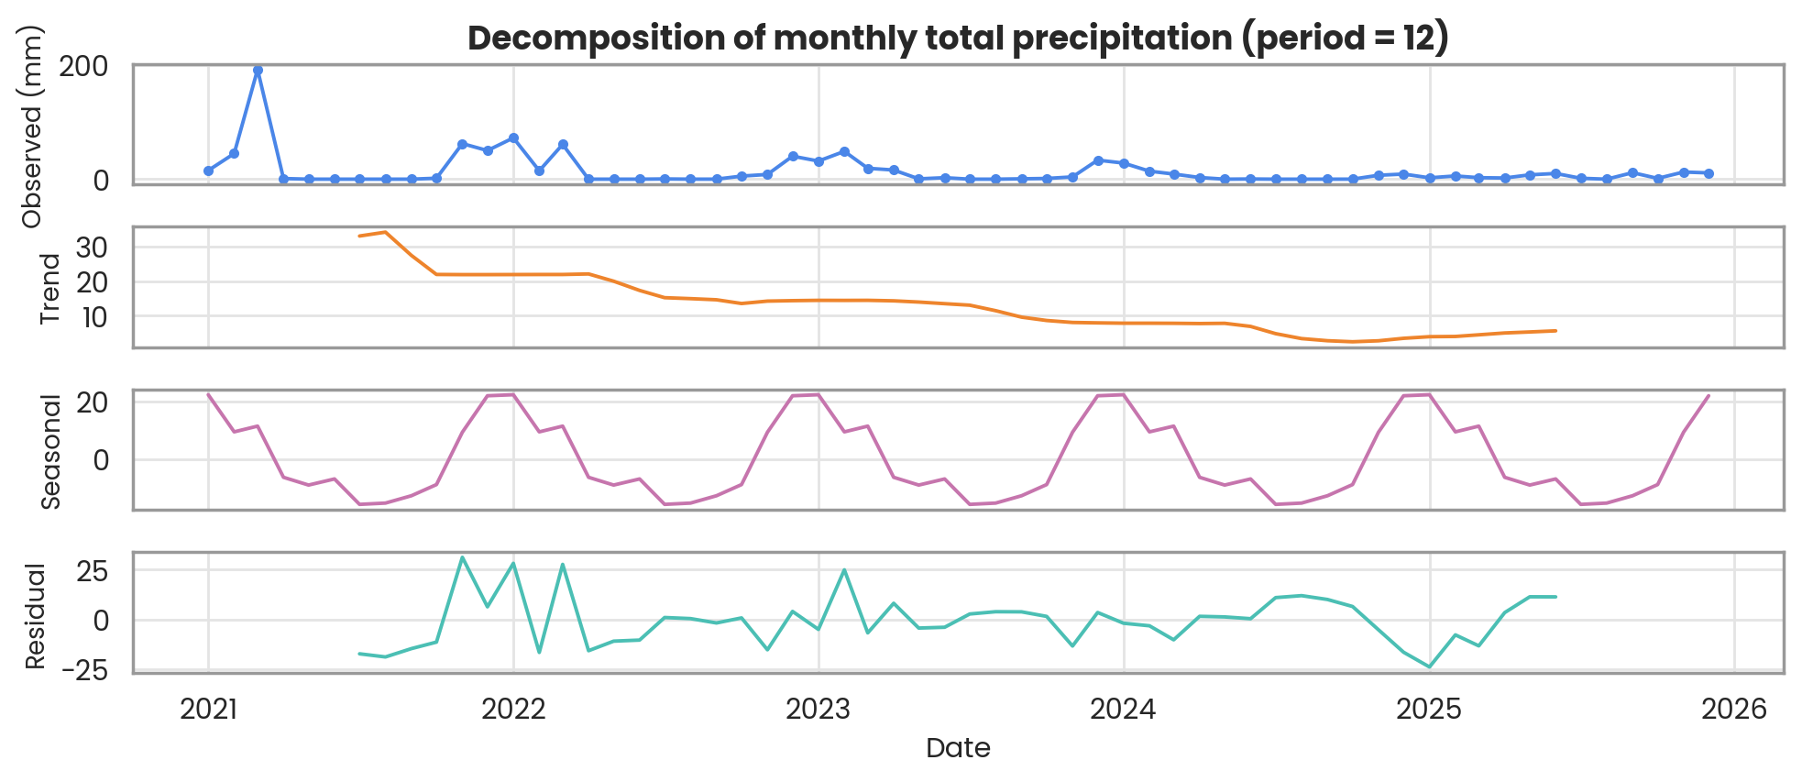
Monthly rain decomposition
Monthly rain totals show a clear winter seasonal pattern (period 12) and a falling level after 2021.

Slide 15
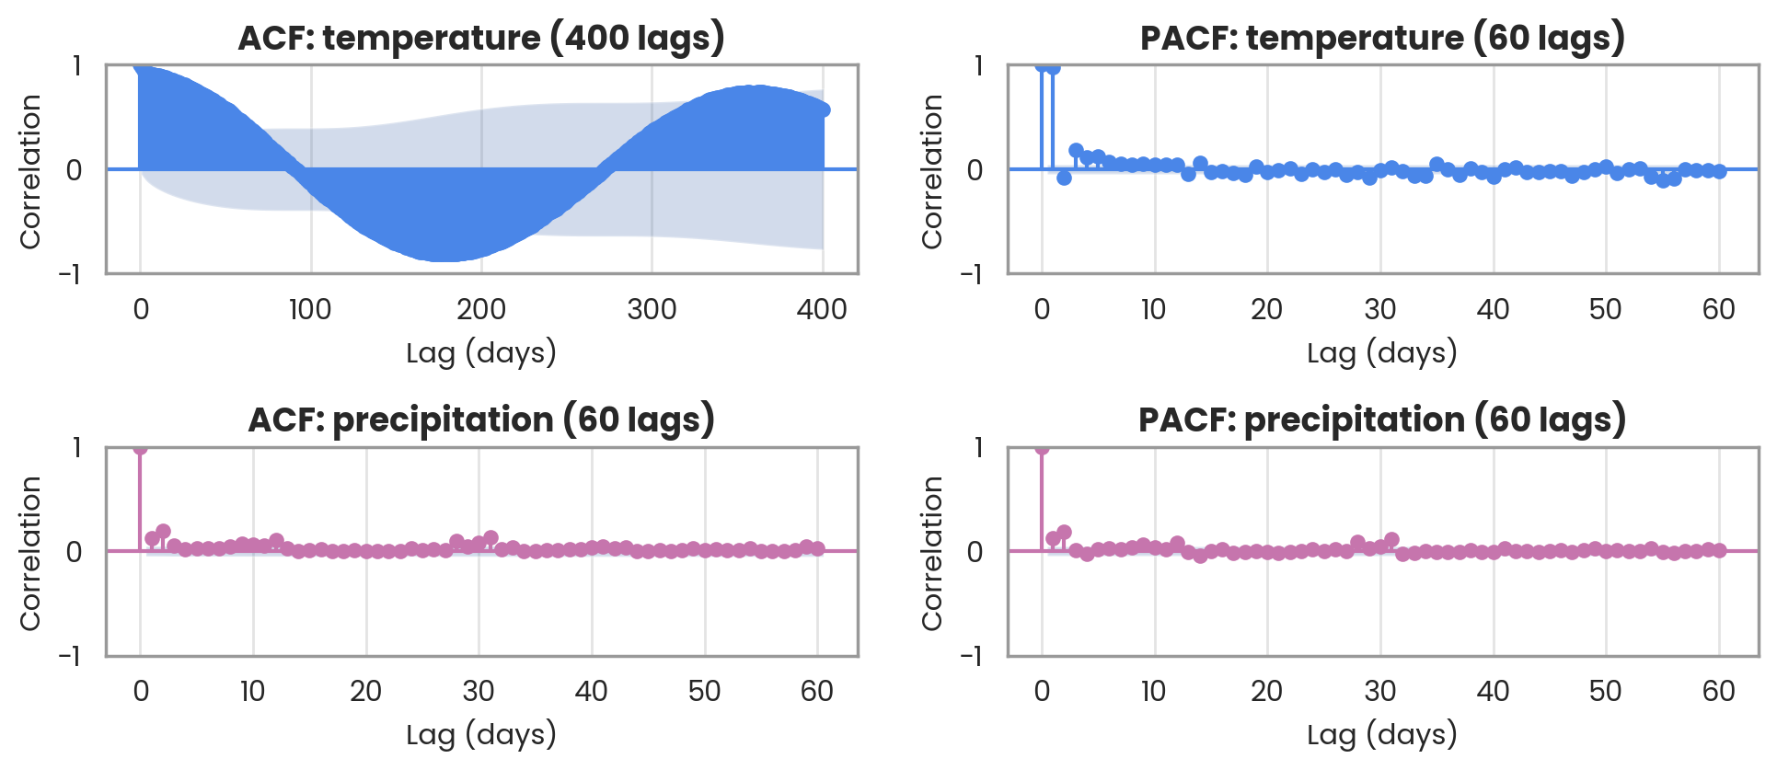
ACF and PACF
Temperature ACF follows the yearly cycle (r = -0.81 at lag 182); rain has only short memory.

Slide 16
Stationarity tests
Series | ADF p | ADF says | KPSS p | KPSS says
Temperature (raw) | 0.186 | Non-stationary | ≥ 0.10 | Stationary
Temperature (deseasonalised) | < 0.001 | Stationary | ≤ 0.01 | Non-stationary
Temperature (1st difference) | < 0.001 | Stationary | ≥ 0.10 | Stationary
Precipitation (raw) | < 0.001 | Stationary | ≤ 0.01 | Non-stationary
ADF H₀: unit root (non-stationary). KPSS H₀: stationary. When the two disagree, the series is not cleanly stationary.
Raw temperature: ADF (p = 0.19) says non-stationary, KPSS disagrees; remove seasonality first.

Slide 17
03
Summary
Answers to the five questions

Slide 18
Summary: region and API
Region & range. Alexandria, Egypt (31.20°N, 29.92°E), daily records from 1 Jan 2021 to 31 Dec 2025 (1,826 days). Five full years give several complete seasonal cycles, which trend, seasonality and decomposition need.
API & why. NASA POWER (daily point endpoint): no API key, so anyone can reproduce the call; global coverage by coordinates; long history; and temperature, rain, humidity, wind and cloud cover in one request.

Slide 19
Summary: patterns and stationarity
Main temporal patterns. A strong yearly temperature cycle (warmest Aug, coolest Feb; seasonal strength 0.93) and only a weak trend: +0.18 °C/yr daily, but not supported by yearly means (p = 0.28). Rain is zero-inflated, 92% falls Nov–Mar, and annual totals fell from 367 to 68 mm.
Is it stationary? Raw temperature: no. ADF cannot reject a unit root (p = 0.19) because the mean follows the season. ADF passes but KPSS still rejects (slow level drift); differencing fixes both. Rain passes ADF but fails KPSS, so model it separately.

Slide 20
Summary: data quality
Issues found. No gaps, duplicates or impossible values (8 checks, all 0). Points to watch: NASA's −999 missing flag; zero-inflated rain with tiny values; and one suspicious spike, 111.6 mm on 19 Mar 2021, isolated between 3.1 mm and 0 mm with ordinary cloud cover (34%).
How I handled them. −999 became NaN before any statistic; gaps of up to 3 days are interpolated for smooth variables, never for rain. Seasonal outliers use rolling z-scores. The 111.6 mm day is kept but flagged to verify against station or news data.

